Slide 1
Virtual functions

Slide 2
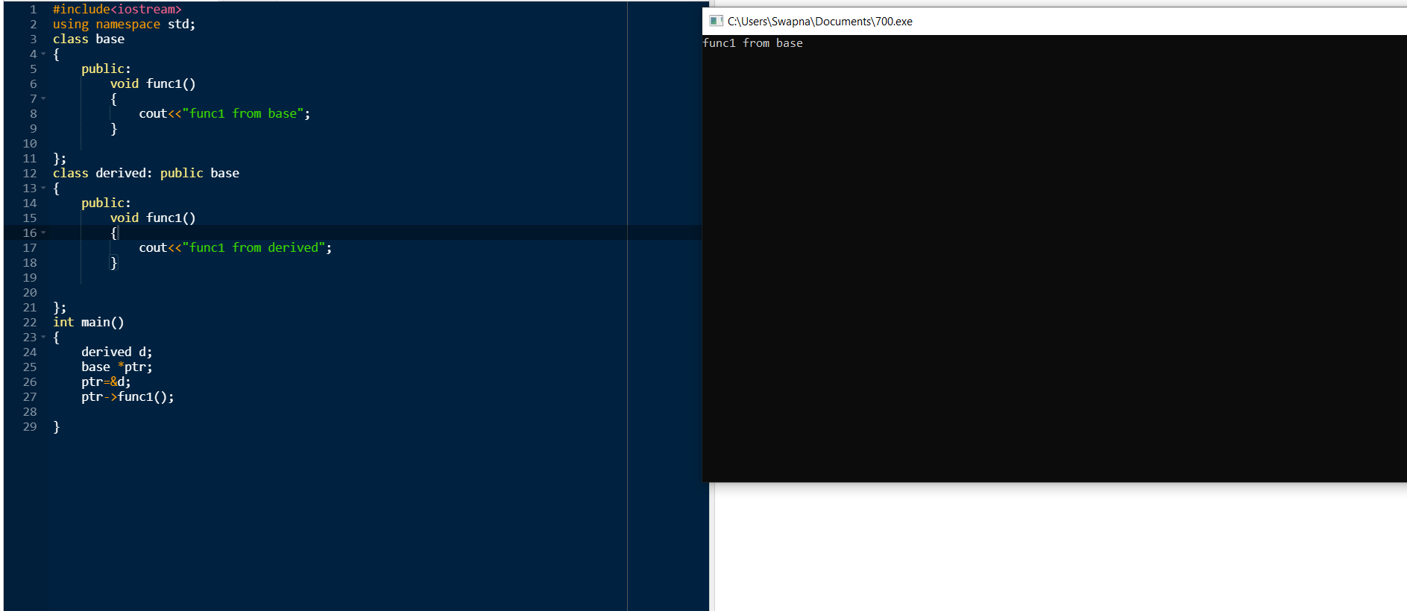

Slide 3
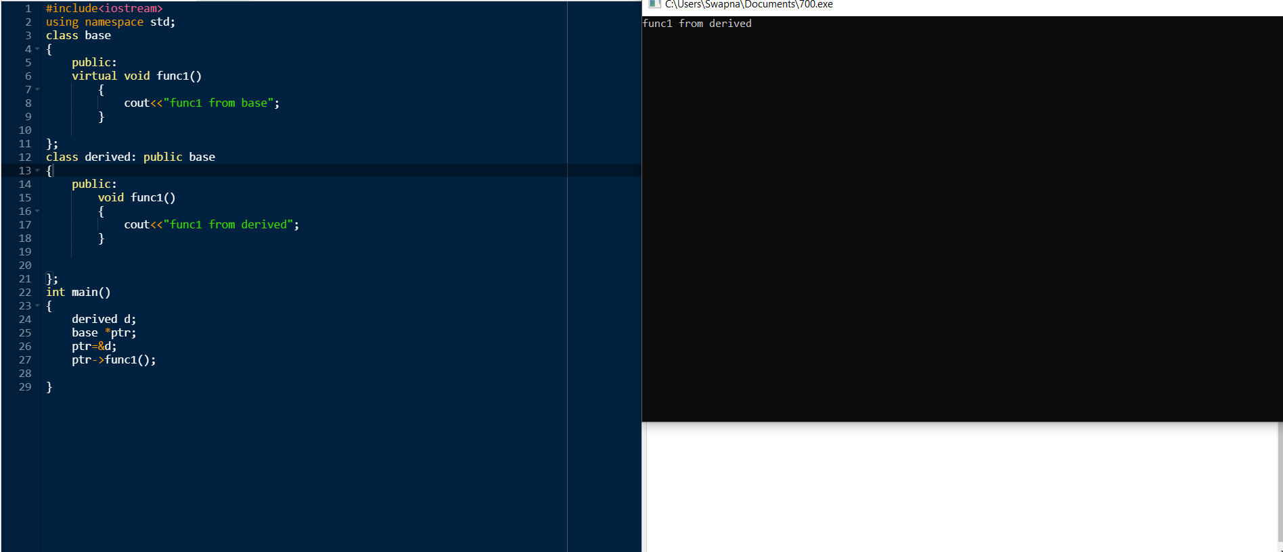

Slide 4
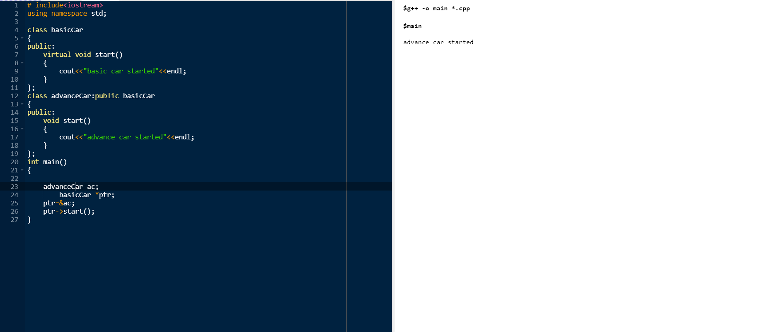

Slide 5
definition
A virtual function is a member function which is declared within a base class and is re-defined(Overriden) by a derived class. When you refer to a derived class object using a pointer or a reference to the base class, you can call a virtual function for that object and execute the derived class’s version of the function.

Slide 6
Virtual functions ensure that the correct function is called for an object, regardless of the type of reference (or pointer) used for function call.
They are mainly used to achieve runtime polymorphism
Functions are declared with a virtual keyword in base class.
The resolving of function call is done at Run-time.

Slide 7
Rules for Virtual Functions
Virtual functions cannot be static and also cannot be a friend function of another class.
Virtual functions should be accessed using pointer or reference of base class type to achieve run time polymorphism.
The prototype of virtual functions should be same in base as well as derived class.
They are always defined in base class and overridden in derived class. It is not mandatory for derived class to override (or re-define the virtual function), in that case base class version of function is used.
A class may have virtual destructor but it cannot have a virtual constructor.

Slide 8
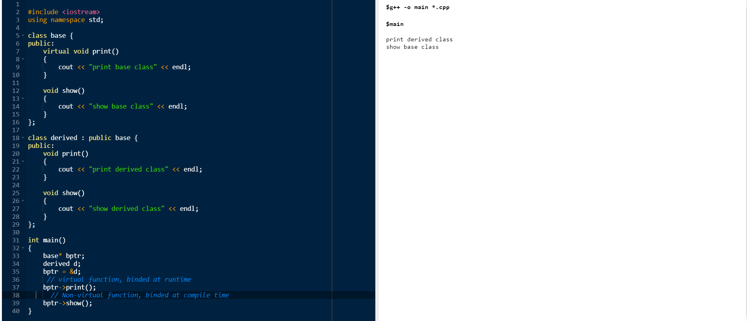
Compile-time(early binding) VS run-time(late binding) behavior of Virtual Functions

Slide 9
Using Virtual Keyword and Accessing Private Method of Derived class
We can call private function of derived class from the base class pointer with the help of virtual keyword. Compiler checks for access specifier only at compile time. So at run time when late binding occurs it does not check whether we are calling the private function or public function

Slide 10
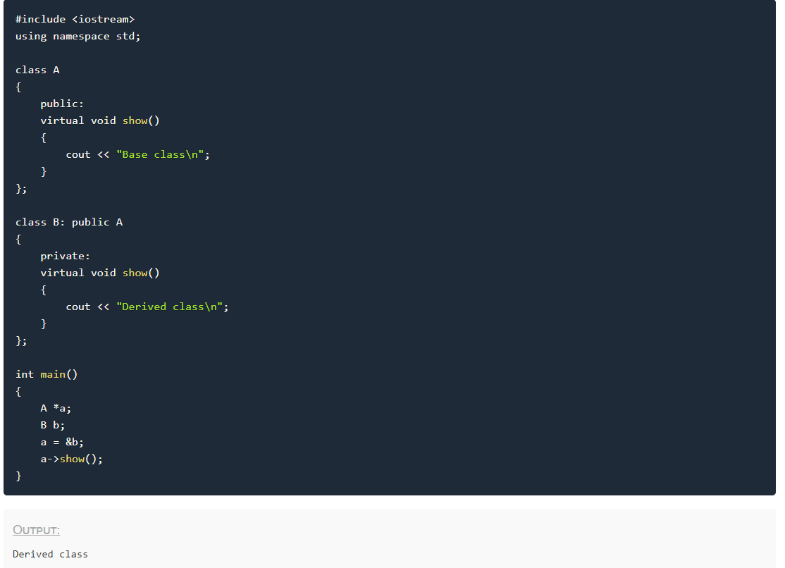

Slide 11
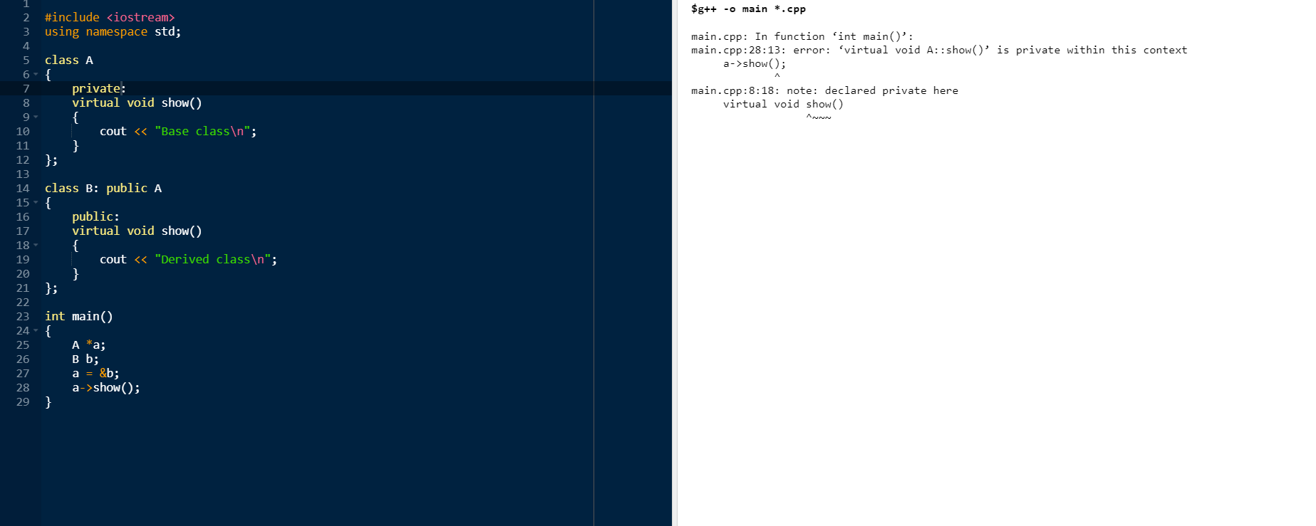

Slide 12
Shape
Virtual print()
Triangle class
Print()
Circle class
Print()

Slide 13
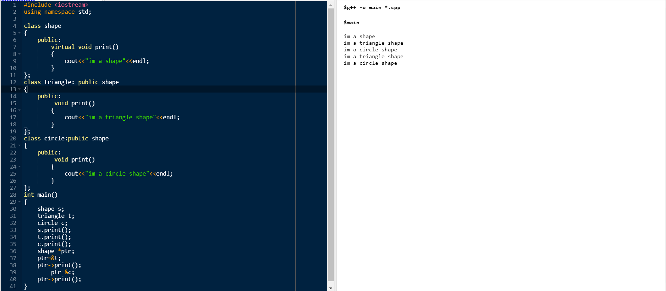

Slide 14
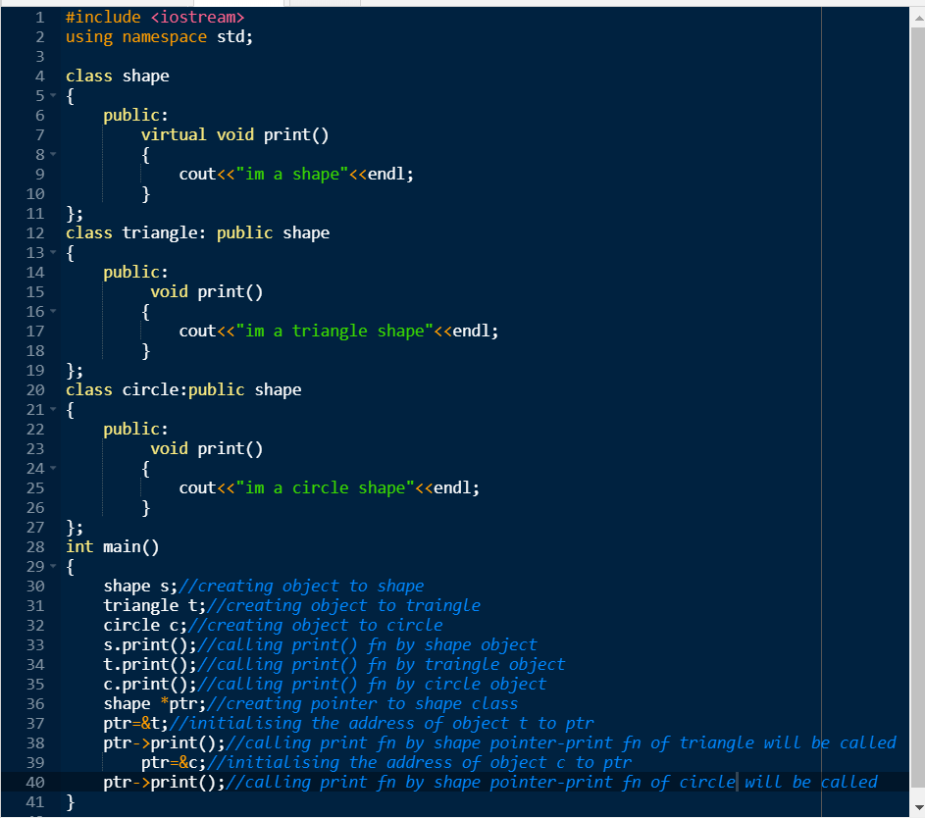

Slide 15
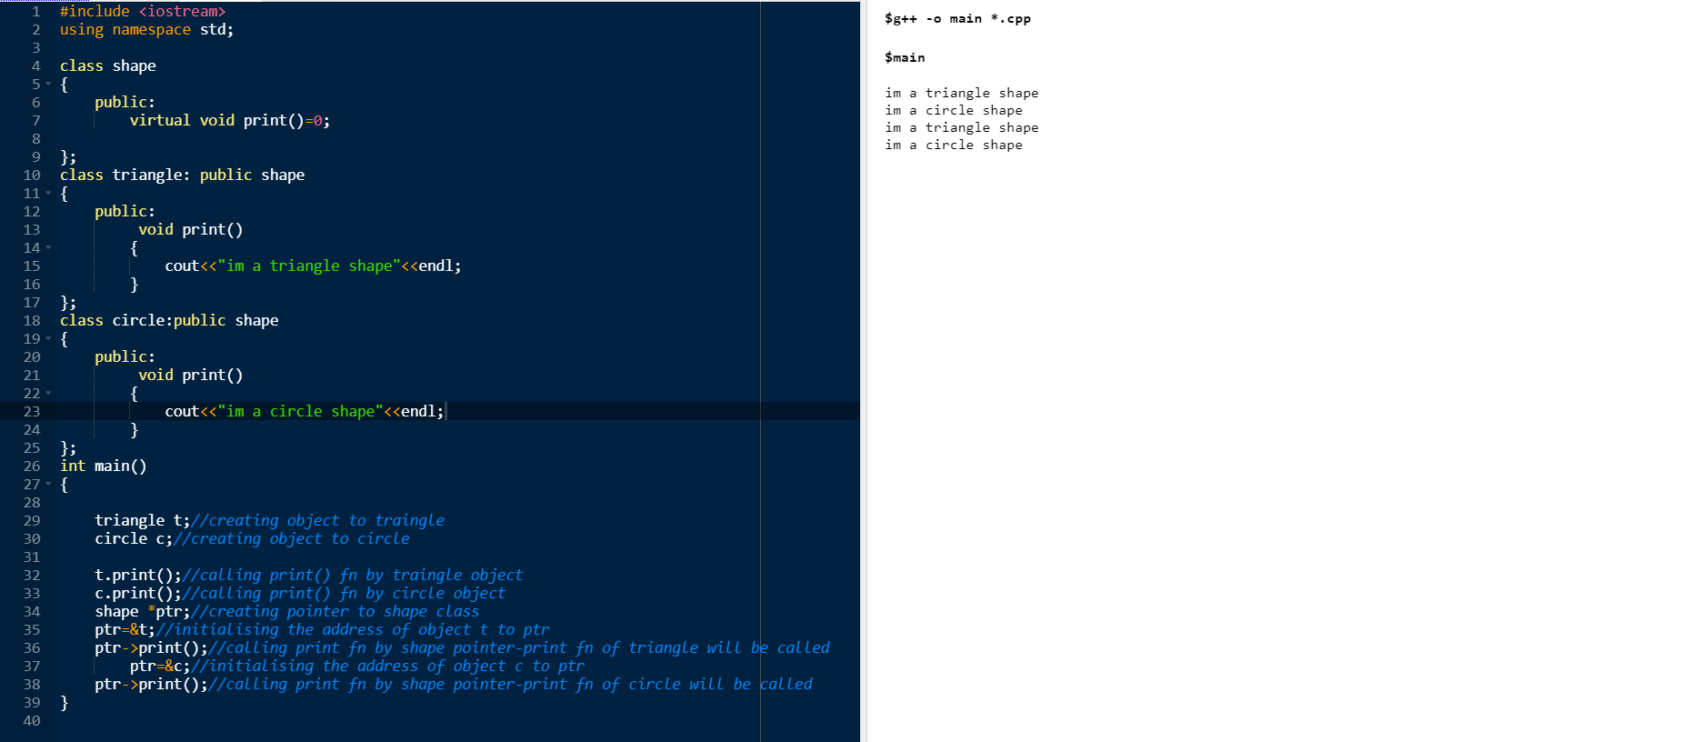
Pure virtual function

Slide 16
definition
A pure virtual function (or abstract function) in C++ is a virtual function for which we don’t have implementation, we only declare it. A pure virtual function is declared by assigning 0 in declaration

